Slide 1
University ID and verification system using Python and regular expressions

Slide 2
introduction
The digital transformation of educational institutions played an important role in the increasing demand for sophisticated technology for data manipulation and verification. The primary goal of this project is to develop an application that is both powerful and user-friendly, through which a user can verify a university ID number's authenticity. The system, which is written in Python, utilizes regular expressions to detect numbers that match a specific pattern—those starting with 44, 45, or 46, and having a total of 7 digits. Users can enter full sentences containing the ID numbers, and the software will carry out the process of filtering out only the valid numbers while the incorrect, duplicate, or invalid numbers will be left out. Hence, the project is improving the quality of data not only but also producing a more vivid and accurate representation in the results that will be experienced by the users during their interaction with the system.

Slide 3
PROBLEM
Input of an incorrect or incomplete ID number
Many users incorrectly type the ID number or forget some digits, and this results in invalid outputs.
Lists numbers in a phrase
Some phrases will contain more than one number which will confuse the program and result in invalid searches.
Input is not the same format every time
Users write things in different styles, such as "my ID is ...", "my ID is...", or written with no format, all making it difficult for the program to validate the input.
Repeated entries or repeated data
When users enter the same phrase more than once, this will result in repeated data or invalid outputs while analyzing data.

Slide 4
SOLUTION
Using a precise regular expression pattern
Normalizing each input before validation
The pattern was developed to allow only numbers that start with 44, 45, or 46 and are then followed by 7 more digits, therefore guaranteeing that the input is valid.
The inputs are all turned to lowercase and the different types of formatting are disregarded thus facilitating and making the pattern matching more accurate.
Extracting only the first matching number from each phrase
Using a set() to store inputs without duplication
The program applies the re.findall method to obtain the proper number from the text, despite the presence of numerous other numbers.
This causes only one check to be done per phrase while at the same time ceasing the production of repeated results.

Slide 5
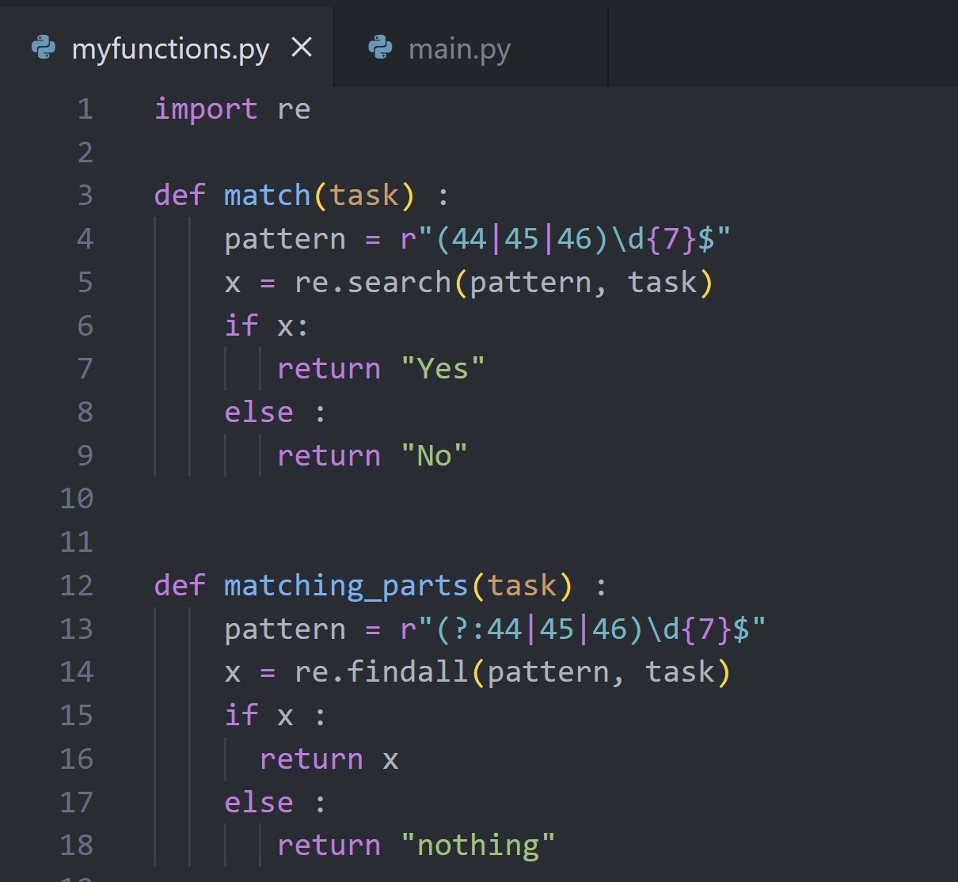
module file

Slide 6
module file
This document has two functions that use a regular expression to find a university ID number in text. The first function, match(task), checks the input for an ID number which starts with either 44, 45, or 46 followed by seven digits. It will return a "Yes" or "No" depending if there are any matches. The second function, matching_parts(task), parses the text and returns all the matching parts of the text in that same format, or "nothing". This separation of validation and extraction keeps the code apparent and organized.

Slide 7
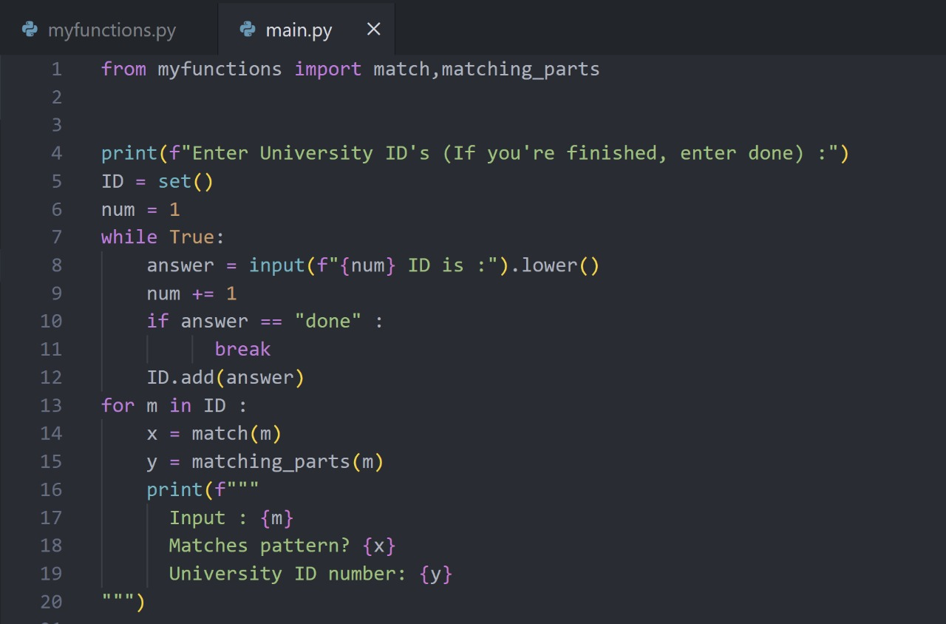
main file

Slide 8
main file
The main program that a user will interact with is in this file. This program begins by prompting the user to enter some phrases that may contain university ID numbers, and continues to prompt for phrases until the user enters "done". The phrases are saved into a set to avoid duplicates, and then each phrase is passed to the match and matching_parts functions imported from the other file. The output for each phrase indicates whether that phrase has a valid ID number and what that ID number is (if there is one). Overall, the code is more accurate and clear due to the new pattern and usage of the code.

Slide 9
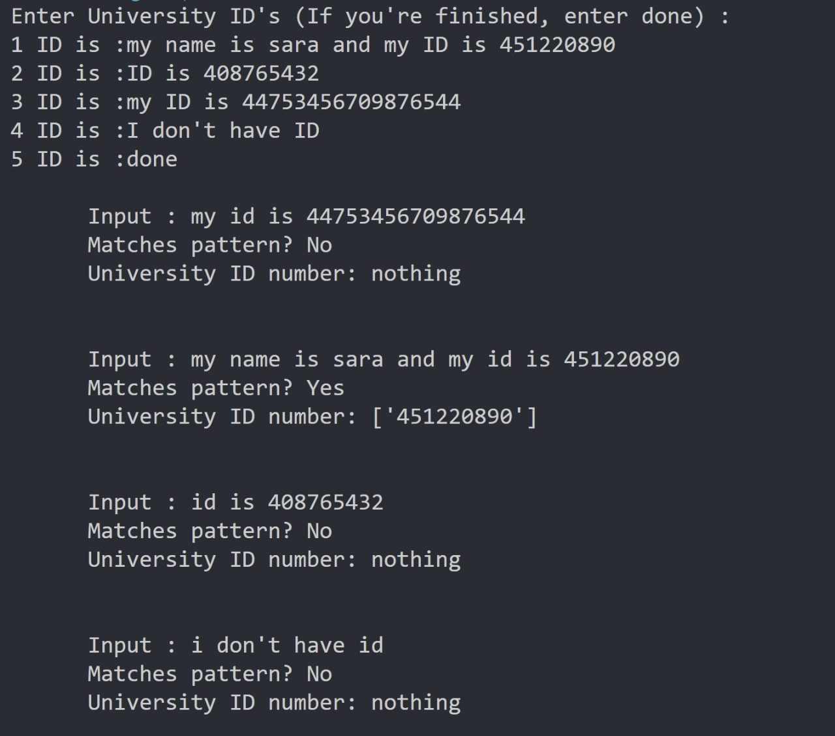
Output

Slide 10
Output
The output shows the response to all of the user's input statements, as well as the validated ID number. The program uses a regular expression to check that the university ID number is a 10-digit number that starts with 44, 45, or 46. The only phrase that worked in this input was "my name is sara and my ID is 451220890," which gave the output "Yes" along with that number as the university ID number. The other phrases either had invalid university ID numbers or no number at all, which is why the output was "No" and "nothing." This shows that the program is correctly checking the ID number against the rules that were set up before.

Slide 11
link
module file
main file

Slide 12
conclusion
In summary, the University ID Verification System demonstrates the successful use of Python and regular expressions to validate user input data and extract specific patterns. The project was able to achieve the objective of allowing users to enter text strings that may contain university ID numbers and validate the text strings. Both the use of sets and regular expressions greatly enhanced accuracy and performance in that records with duplicates were removed and validated records were valid university ID numbers. The project exhibited the importance of both validating data as well as recognizing patterns in applications especially with educational institutions that use systematic and digital systems of verification.

Slide 13
THANK YOU

